Slide 1
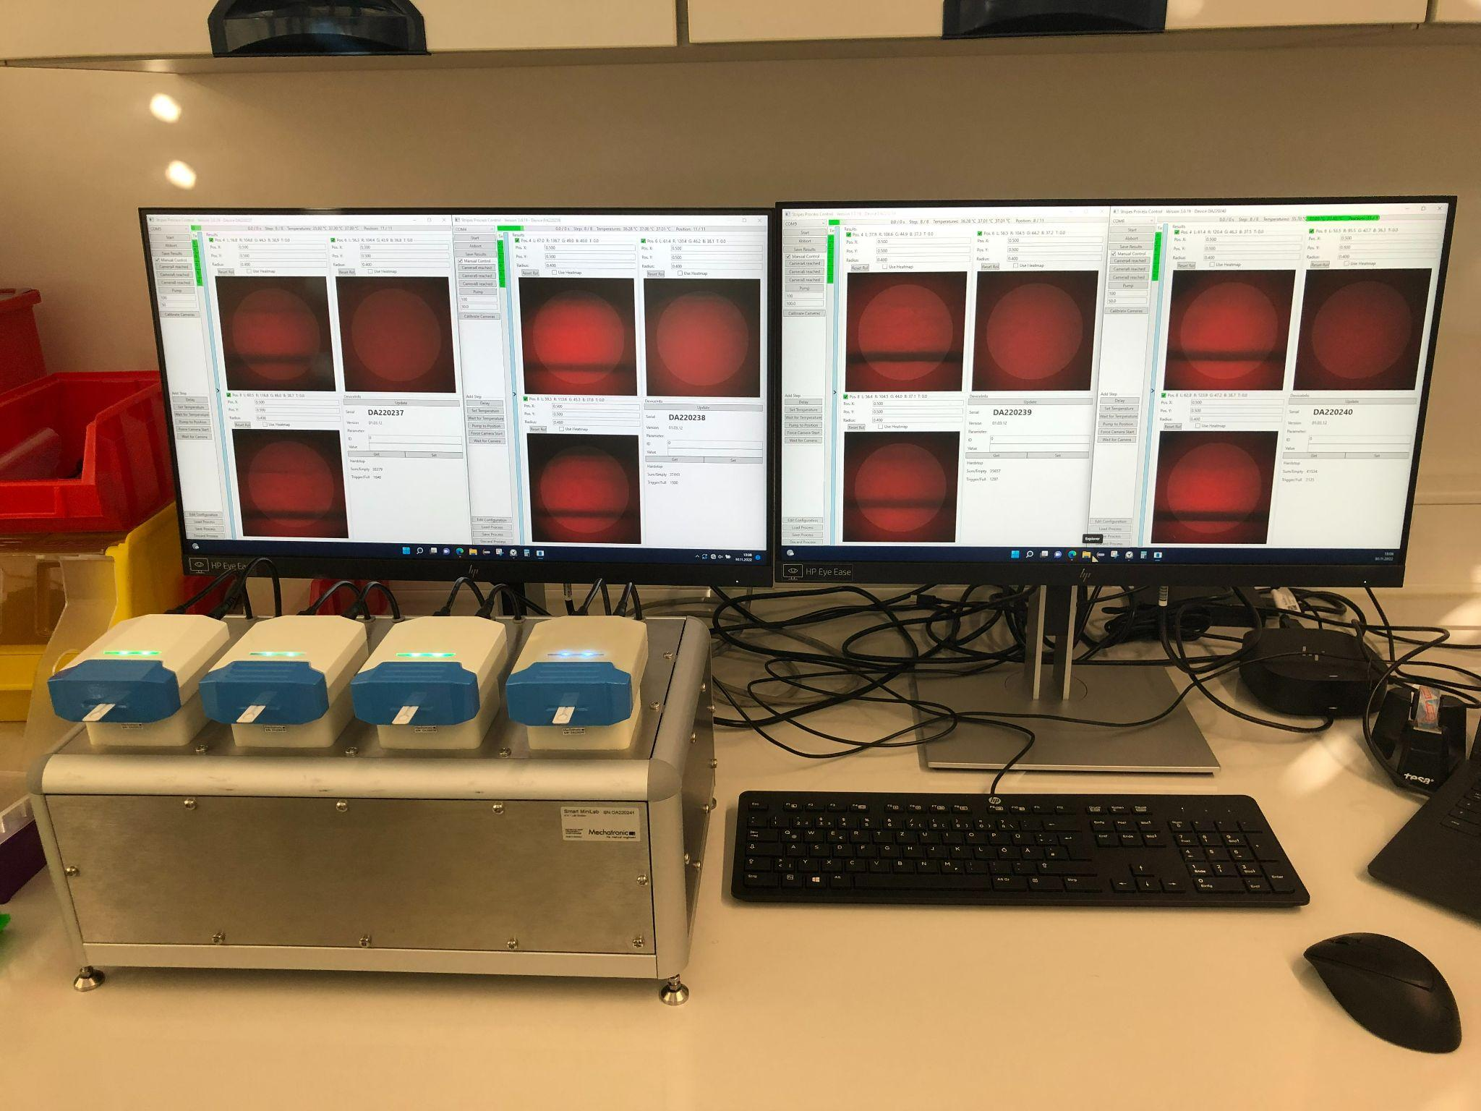
Image processing technique to extract optical signals from glucose teststrip
Anna Rose Johny
31.01.2023 | confidentiality level

Slide 2
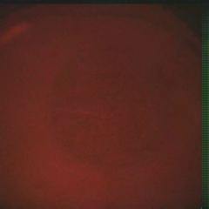
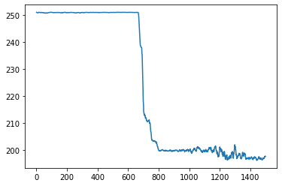
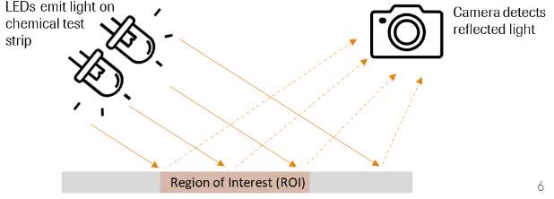
Data collection and signal extraction
ROI detection
Raw images
Signal
Frames

Slide 3
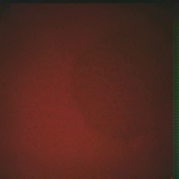
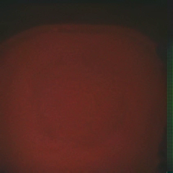
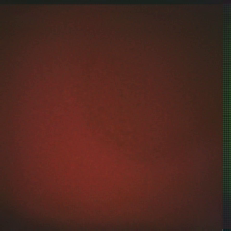
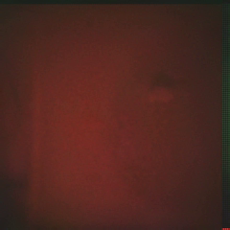
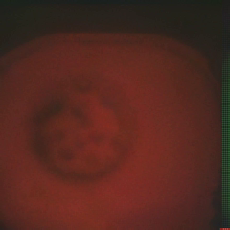
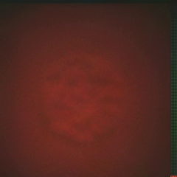
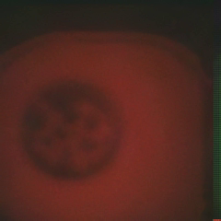
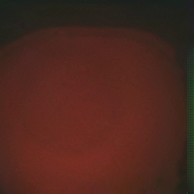
Why ROI detection is necessary?
Increasing complexity due to change of ROI positions
Increasing complexity due low signal, uneven edges, unequal sizes

Slide 4
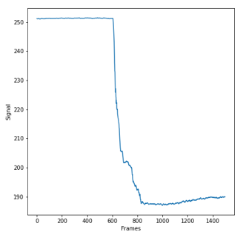
Framework developed during my internship
Preprocessing
Normalization
Gaussian Blur
Segmentation
Erosion
Otsu thresholding
Post-processing
Morphological closing
Canny edge detection
Raw images
Signal extraction
ROI detection
Circle detection
Output

Slide 5
Step 1: Image preprocessing
Converting image to more suitable form that can be used for producing more suitable results
Preprocessing
Normalization
Gaussian Blur
Segmentation
Erosion
Otsu thresholding
Post-processing
Morphological closing
Canny edge detection
Raw images
Signal extraction
ROI detection
Circle detection
Output

Slide 6
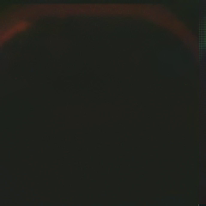
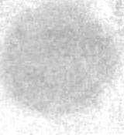
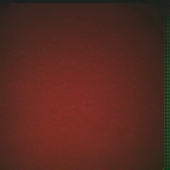
Preprocessing: Image Normalization to enhance Signal
Frames obtained by the camera are normalized w.r.t. the initial reﬂectivity prior to the start of the chemical reaction
To this end, a set of calibration frames are recorded before the chemical reaction starts
Dark frames/light frames obtained prior to the insertion of the test strip into the device without/with illuminating the LEDs
Raw image
﹣
Raw image
Dark image
͇
﹣
Normalized image
Normalized image
Light image
Dark image

Slide 7
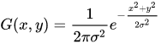
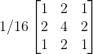
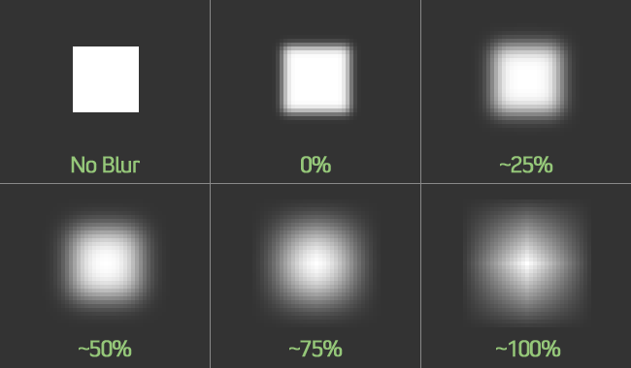

Preprocessing: Gaussian blur
Formula of Gaussian function
E.g. of a Gaussian kernel(3×3)
Normalized image
Gaussian blurred image

Slide 8
Step 2: Image Segmentation
Partitioning image into different regions based on characteristics of pixels
Preprocessing
Normalization
Gaussian Blur
Segmentation
Erosion
Otsu thresholding
Post-processing
Morphological closing
Canny edge detection
Raw images
Signal extraction
ROI detection
Circle detection
Output

Slide 9
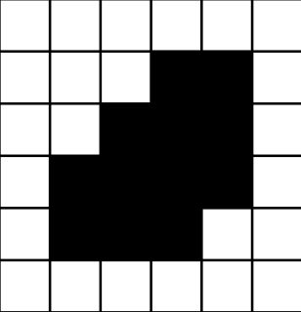
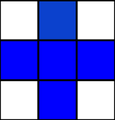

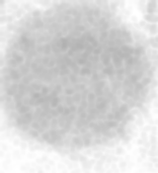

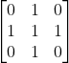
Segmentation: Erosion
Gaussian blurred image
Eroded image
E.g. of (3×3) kernel

Slide 10
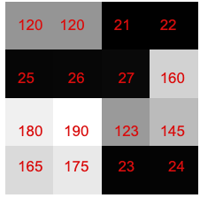
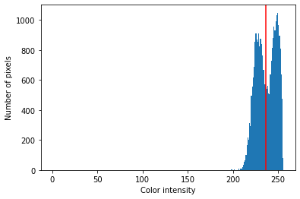
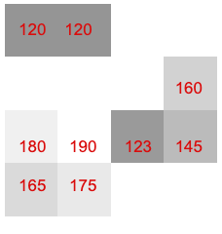
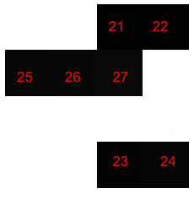

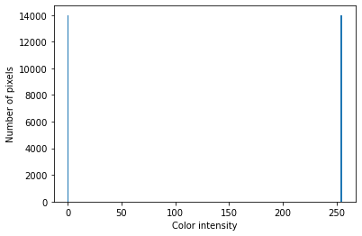
Segmentation: Otsu thresholding
Eroded image
Histogram of gray image
Raw image
Thresholded image
Histogram of thresholded image
Foreground, T >100
Background,
T <100

Slide 11
Step 3: Post-processing
Techniques used to enhance the properties of an image
Preprocessing
Normalization
Gaussian Blur
Segmentation
Erosion
Otsu thresholding
Post-processing
Morphological closing
Canny edge detection
Raw images
Signal extraction
ROI detection
Circle detection
Output

Slide 12
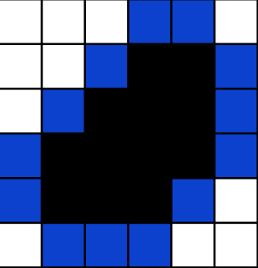
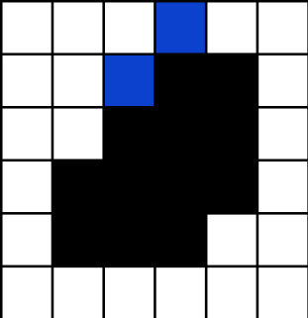
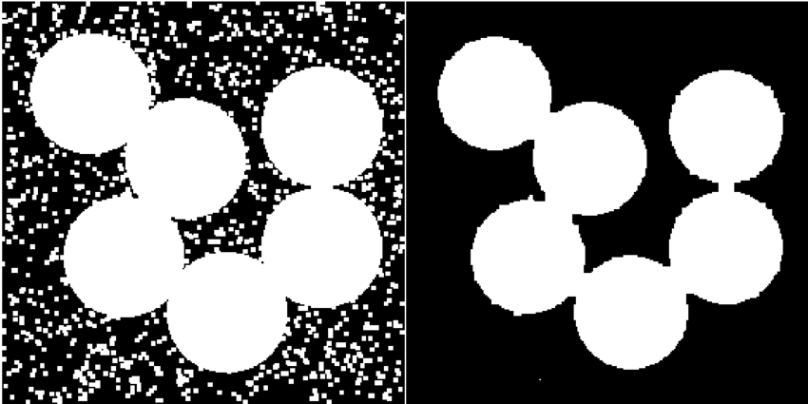

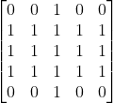
Post-processing: Morphological closing
Thresholded image
Closed image
E.g. of (5×5) kernel

Slide 13
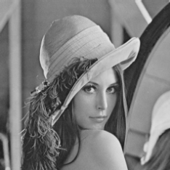
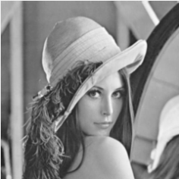
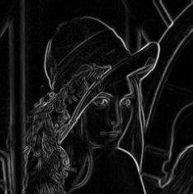
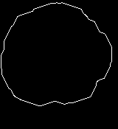
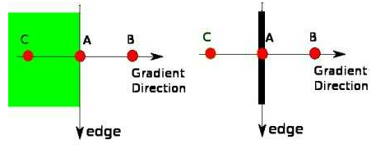
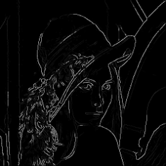
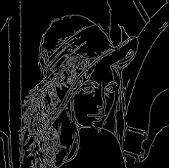
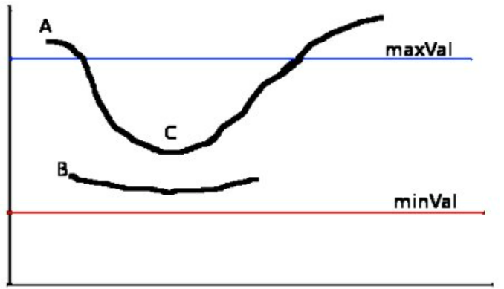
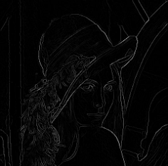
Post-processing: Canny edge detection
Steps in canny edge detection
Closed image
Raw image
Blurred image
Sobel filter
Canny edge detection
Edge detection
Double thresholding
Non-maximum suppression

Slide 14
Step 4: ROI detection
Preprocessing
Normalization
Gaussian Blur
Segmentation
Erosion
Otsu thresholding
Post-processing
Morphological closing
Canny edge detection
Raw images
Signal extraction
ROI detection
Circle detection
Output

Slide 15
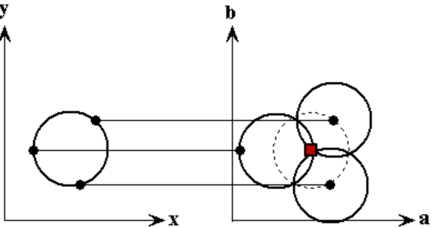
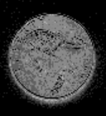

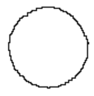
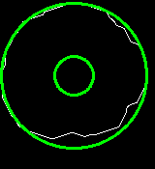
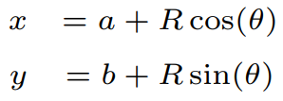

Circle Detection (ROI selection)
Technique to find imperfect instances of object
Image
Canny edge detection
Binary image
Parameter estimation
Edge detection
ROI detection
Hough transform
Detected circle

Slide 16
Step 5: Signal extraction
Mean over signals are calculated and plotted
Preprocessing
Normalization
Gaussian Blur
Segmentation
Erosion
Otsu thresholding
Post-processing
Morphological closing
Canny edge detection
Raw images
Signal extraction
ROI detection
Circle detection
Output

Slide 17

Signal extraction

Slide 18
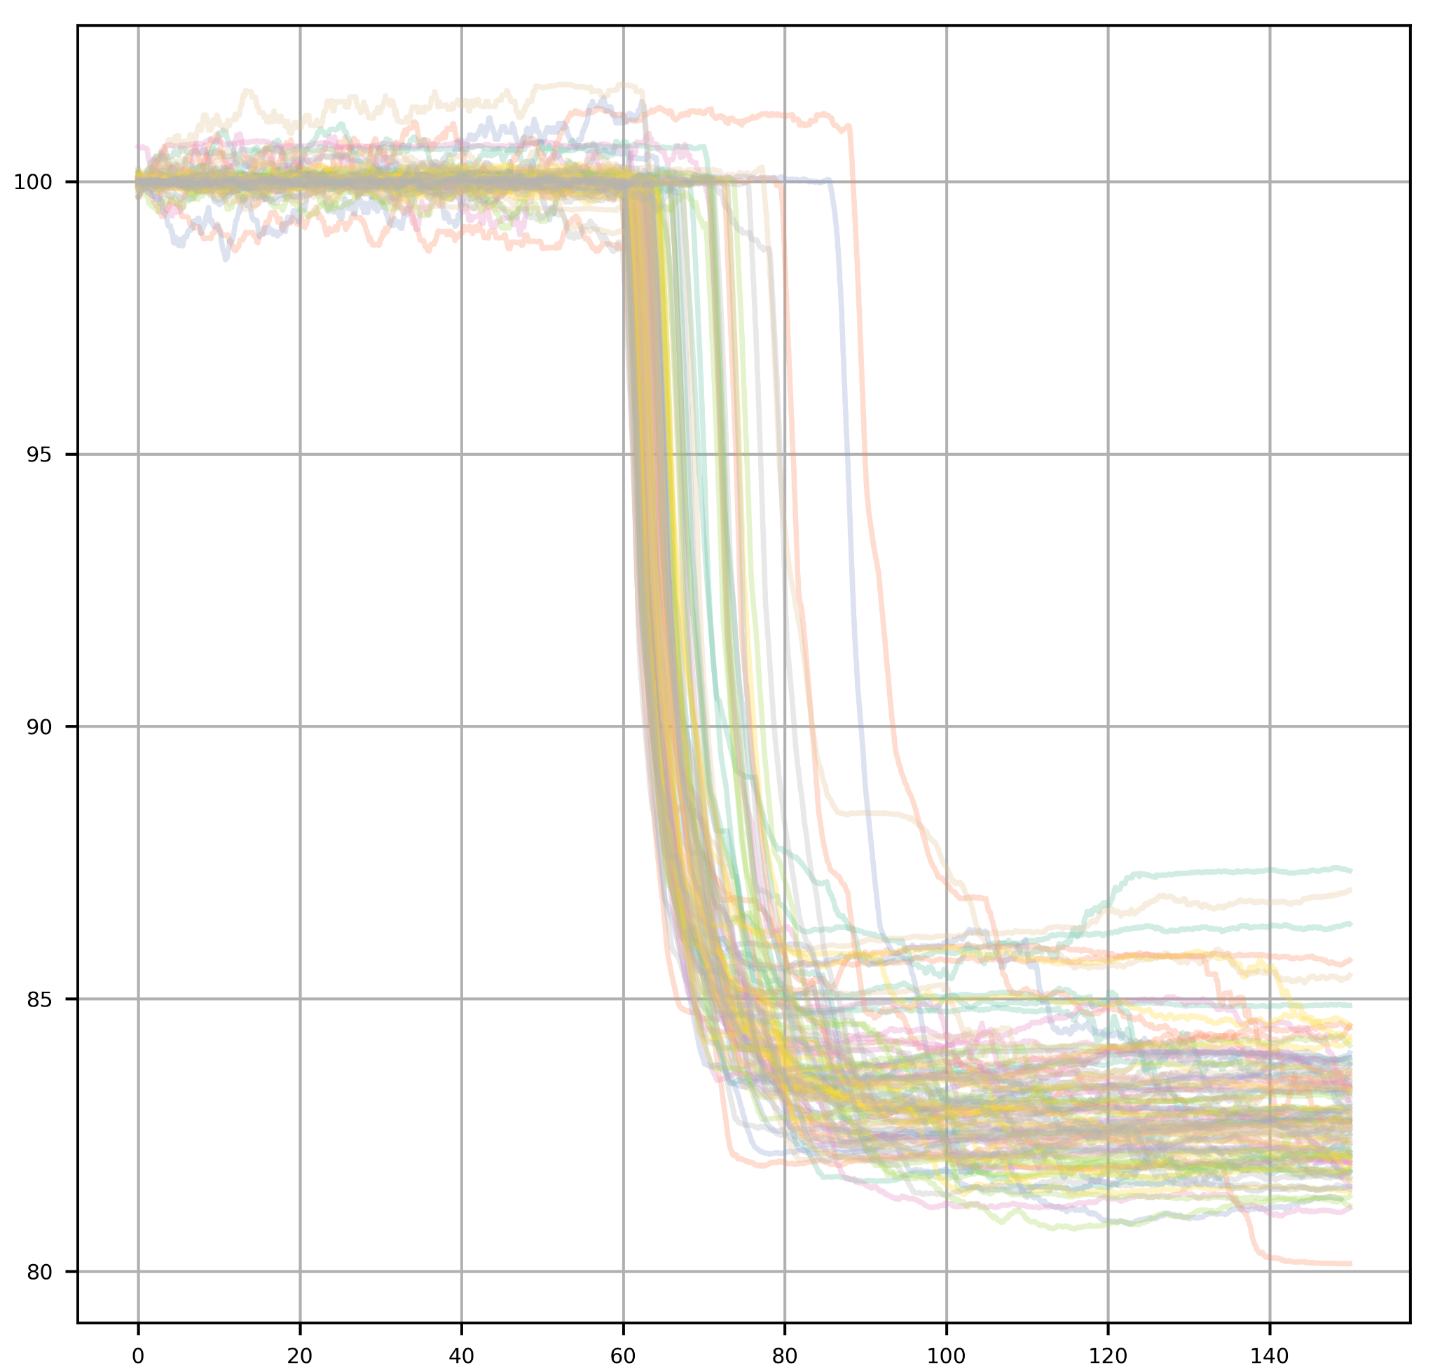
Summary of my internship
We evaluated a total of 99 samples and proposed method was robust enough to detect ROI in all cases
Used this algorithm to characterize Smartminilab device
Same approach can be used for different project that uses image processing technique in detecting patterns from the test strip
Signals
Frames

Slide 20
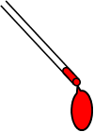
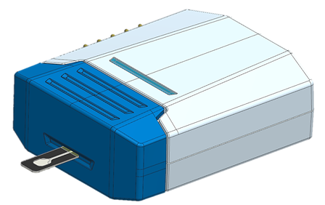
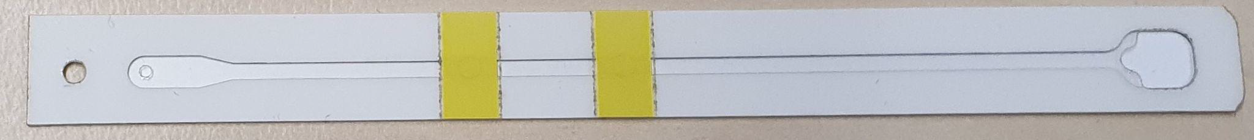
Vision of the Universal Functional Disposal (UniFudi) Project

Slide 21

Smart Mini Lab Gen 3 - Overview

Slide 22



Exemplary measurement procedure at UniFudi project
Start
Endogenous interferents
Measurement
Temperature control with peltier elements
Place Teststrip in Smart Mini Lab
Sample transport to PreReaction Pad with manual control of micropump
Incubation for interferent degradation
Sample transport to Reaction Pad with manual control of micropump
Data collection with camera

Slide 23


